Slide 1
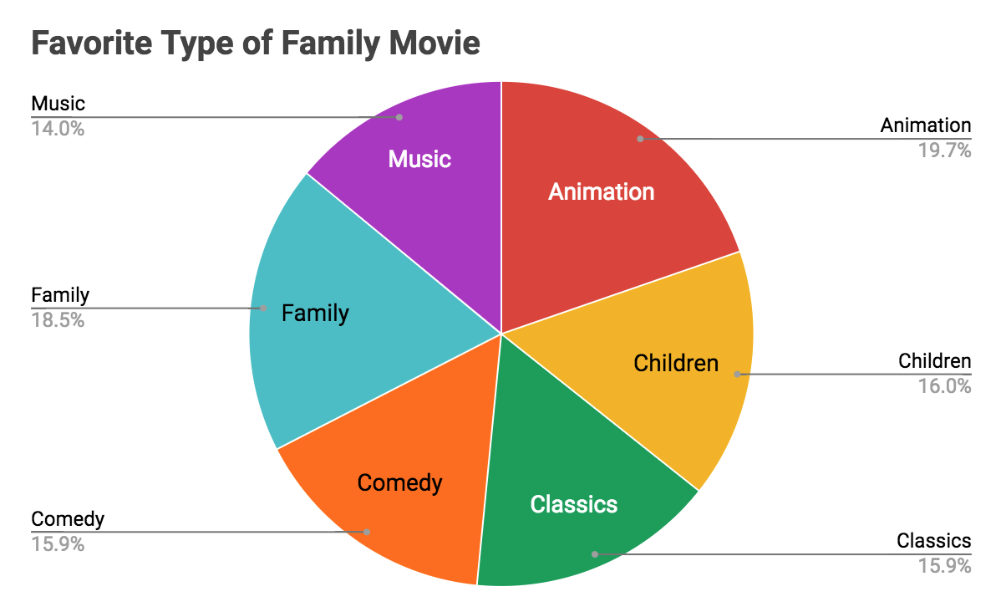
What is the most favorite category in family movie?
We can see the most popular movie genre in family movie is animation, which has the highest number of rental.

Slide 2
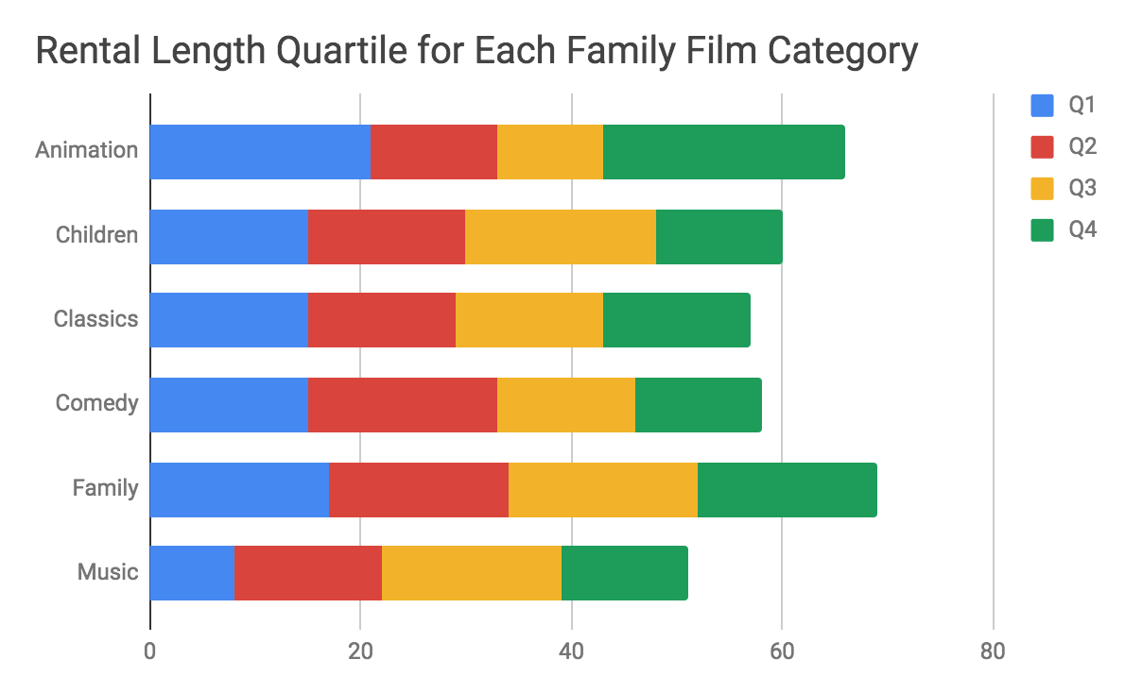
Which type of movies are customers less likely to rent for long time?
We can see customers are less likely to rent comedy, children and music movies for long time.

Slide 3
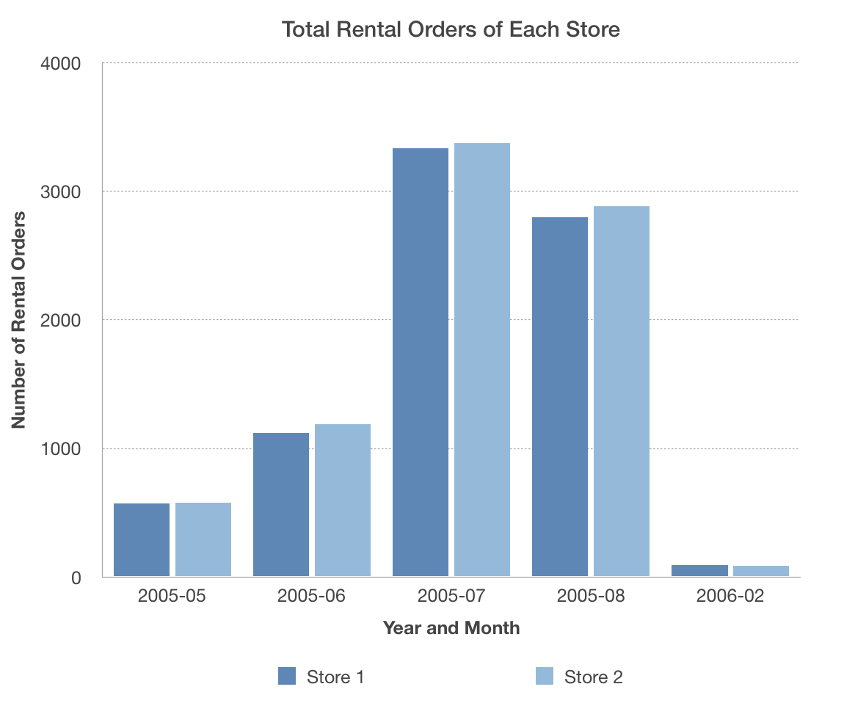
What were the total rental orders per store?
We can see both store got almost the same number of rental orders during each time unit.

Slide 4
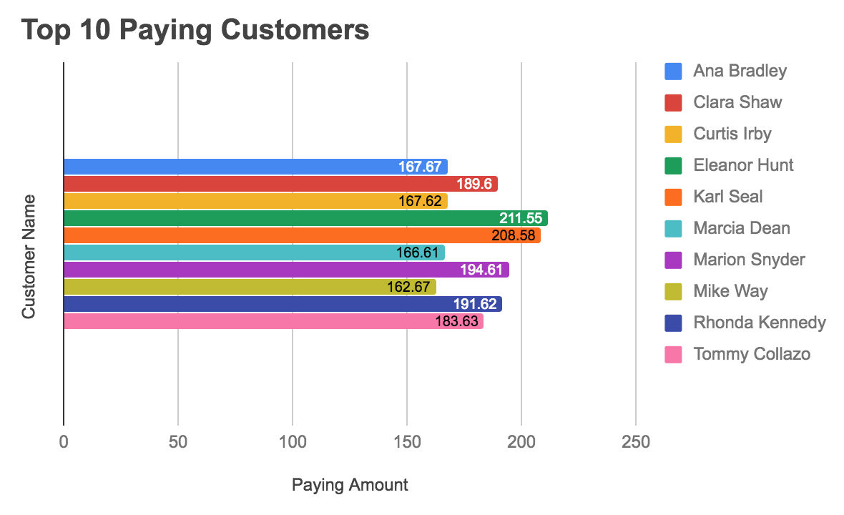
Who were the top 10 paying customers?
We can see who were the top 10 paying customers and Eleanor Hunt is the top 1 paying customer with paying amount $211.55.

